Slide 1
Lecture 1. Introduction to Data Communications
Business Data Communications and Networking Fitzgerald and Dennis, 7th Edition
Copyright © 2002 John Wiley & Sons, Inc.

Slide 2
Data Communications Networks

Slide 3
Datacom Basics
Data Communications: the movement of computer information from one point to another by means of electrical or optical transmission systems (called networks).
Telecommunications: broader term that includes the transmission of voice and video, as well as data, and may imply longer distances.
Although once considered separate phenomenon, telecom & datacom are in the process of “converging” into a single “broadband” communications technology.

Slide 4
Network Components
Local area networks contain three basic hardware components (see Figure 1-1):
Servers (also called hosts or host computers)
Clients
Circuits
Clients and Servers typically work together in client-server networks. Networks without servers are called peer-to-peer networks.
Routers are specialized devices responsible for moving information between networks, are also a common network component.
Server types: file servers, print servers, Web servers, e-mail and directory servers.

Slide 5
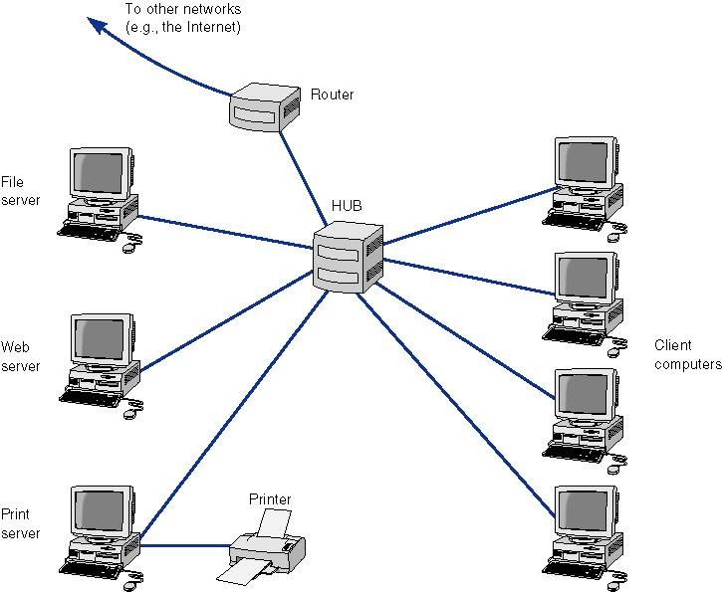
Figure 1-1. Components of a Network

Slide 6
Network Types (Figure 1-2)
A common way of thinking about networks is by the scale of the network. 4 common network types are:
Local Area Networks (LANs) which typically occupy a room or building, usually include a group of PCs that share a circuit.
Backbone Networks, have a scale of a few hundred meters to a few kilometers. Include a high speed backbone linking the LANs at various locations.
Metropolitan Area Networks (MANs) which typically have a scale of a few kilometers to a few tens of kilometers & connects LANs and BNs at different locations, often using leased lines or other commercial services to transmit data.
Wide Area Networks (WANs) have a scale of hundreds or thousands of kilometers. Like MANs, leased circuits or other commercially available services are used to transmit data.

Slide 7
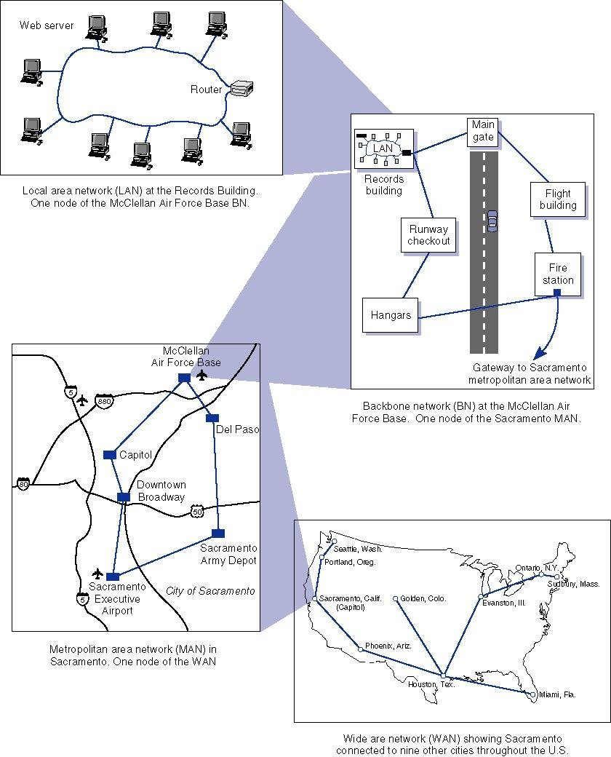
Figure 1-2. Network Types by Scale

Slide 8
Intranets and Extranets
Intranets are networks that have been set up so that Web sites or other applications can be used over private networks.
Extranets also use Internet technology by providing customer access to secure corporate Web sites. Extranet access is usually controlled using passwords, but newer technologies such as smart cards are also being used.

Slide 9
Network Models

Slide 10
Multi-layer Network Models
The process of transferring a message between sender and receiver is more easily implemented by breaking it down into simpler components.
Instead of a single layer, a group of layers are used, dividing up the tasks required for network communications.
The two most important such network models are the OSI and Internet models.

Slide 11
The OSI Networking Reference Model
Stands for Open Systems Interconnection
Created by the International Standards Organization (ISO) as a framework for computer network standards
Released in 1984, the model has 7 layers (see Figure 1-3).

Slide 12
The OSI 7-layer Model
Application: provides a set of utilities used by application programs
Presentation: formats data for presentation to the user, provides data interfaces, data compression and translation between different data formats
Session: responsible for initiating, maintaining and terminating each logical session between sender and receiver
Transport: deals with end-to-end issues such as segmenting the message for network transport, and maintaining the logical connections between sender and receiver
Network: responsible for making routing decisions
Data Link: deals with message delineation, error control and network medium access control
Physical: defines how individual bits are formatted to be transmitted through the network

Slide 13
The Internet (TCP/IP) Protocol Suite
Stands for Transmission Control Protocol/ Internet Protocol. Used on the Internet.
TCP/IP’s 5 layer suite was developed to solve to the problem of internetworking
Network layers can also be placed in three groups:
application layer (includes the application layer),
internetwork layer (includes the transport and network layers)
hardware layer (includes the data link and physical layers).
See Figure 1-3.

Slide 14
The Internet’s 5-Layer Model
Application: used by application program
Transport: responsible for establishing end-to-end connections, translates domain names into numeric addresses and segments messages
Network*: responsible for end-to-end addressing and routing, determines destination address if unknown
Data Link*: deals with message delineation, error control & network access
Physical*: defines how information will be transmitted through the network
*same as corresponding layer in OSI model

Slide 15
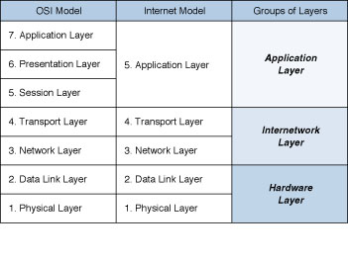
Figure 1-3: Network Models

Slide 16
Message Transmission Using Layers (Figure 1-4)
Network model layers use protocols, i.e., sets of rules to define how to communicate at each layer and how to interface with adjacent layers.
Generally, messages travel down all network layers.
When a message is sent to the next layer, that layer places it in an envelope and adds addressing information related to that layer.
At the receiving end, messages travels up through the network layers, each layer removing the envelopes added when the message was sent.

Slide 17
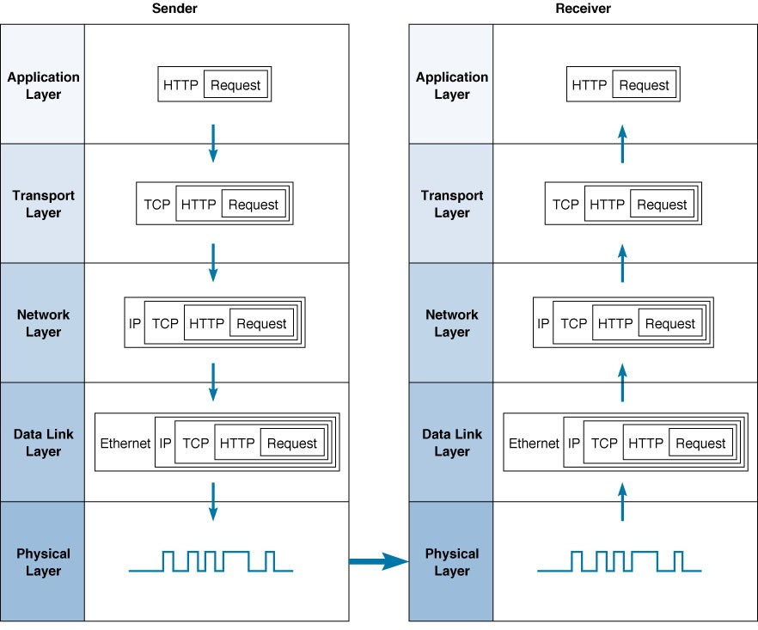
Fig. 1-4 Message transmission using layers

Slide 18
Networking Example: clicking on a WWW hyperlink
Clicking on a hyperlink starts an HTTP request-response cycle. First, the user’s browser sends an HTTP request.
The HTTP request is then handed to the transport layer’s TCP protocol and placed in a TCP segment.
The TCP segment is placed in an IP (network layer) packet.
The IP packet is next placed in a Data Link layer (such as Ethernet) frame and sent out over the network media as a series of 1s and 0s defined by the physical layer.
On the web server, this process occurs in reverse, each layer removing the overhead information added by each layer until the HTTP request is finally produced for the server to read.
The server then sends an HTTP response back to the client which is sent back to the user’s browser.

Slide 19
Network Standards

Slide 20
Why Standards?
Standards provide a fixed way for hardware and/or software systems to communicate.
For example, USB enables two pieces of equipment to interface even though they are manufactured by different companies.
By allowing hardware and software from different companies to interconnect, standards help promote competition.

Slide 21
Types of Standards
There are two main types of standards:
Formal: a standard developed by an industry or government standards-making body
De facto: standards that emerge in the marketplace and are widely used, but lack official backing by a standards-making body

Slide 22
The Standardization Processes Three Steps
Specification: developing the nomenclature and identifying the problems to be addressed.
Identification of choices: identify solutions to the problems and choose the “optimum” solution.
Acceptance: defining the solution, getting it recognized by industry so that a uniform solution is accepted.

Slide 23
Some Major Standards Making Bodies
ISO: International Organization for Standardization (www.iso.ch)
ITU-T: International Telecommunications Union –Telecom Group (www.itu.int)
ANSI: American National Standards Institute (www.ansi.org)
IEEE: Institute of Electrical and Electronic Engineers (see standards.ieee.org)
IETF: Internet Engineering Task Force (www.ietf.org)

Slide 24
Fig. 1-5. Some data communications standards
Layer
Common Standards
5. Application layer
HTTP, HTML (Web)
MPEG, H.323 (audio/video)
IMAP, POP (e-mail)
4. Transport layer
TCP (Internet)
SPX (Novell LANs)
3. Network layer
IP (Internet)
IPX (Novell LANs)
2. Data link layer
Ethernet (LAN)
PPP (dial-up via modem)
1. Physical layer
RS-232c cable (LAN)
Category 5 twisted pair (LAN)
V.92 (56 kbps modem)

Slide 25
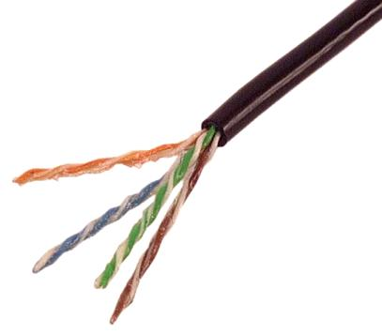
Twisted Pair

Slide 26
Future Trends

Slide 27
Three Emerging Trends in Networking
Pervasive Networking
The Integration of Voice, Video and Data
New Information Services

Slide 28
Pervasive Networking
The pervasive networking means:
network use will continue to grow exponentially
network access is everywhere
many new types of devices will have network capability
Data rates for all kinds of networking will also continue to grow exponentially, reaching Gigabit per second ranges later in this decade

Slide 29
The Integration of Voice, Video & Data
Also called convergence, integration means that telecom systems that were previously transmitted using separate networks will merge into a single, high speed, multimedia network in the near future.
The first step is the integration of voice and data, which is already underway.
Later, video will merge with voice and data. This step will take longer partly due to the high data rates required for video.

Slide 30
New Information Services
With the World Wide Web, many new types of information services becoming available.
Another trend is the growth of Application Service Providers (ASPs) that develop systems for companies, such as providing and operating a payroll system for a company that does not have one of its own.

